Slide 1



Executive Strategy: Urgency & Market Analytics
Product leadership is exploring the rollout of urgency messaging across Agoda’s booking funnel. Analyzing 48,914 real bookings (Oct–Dec 2016) across 5 cities reveals critical flaws in standard industry assumptions and outlines a highly targeted commercial strategy.
Core Analytical Findings
The "Price Drop" Paradox: Prices drop by ~30% as check-in approaches ($170 down to $119). "Prices are rising!" copy is factually incorrect for the majority of inventory.
Massive Urgency Market: 47.9% of all bookings occur within 7 days of check-in, confirming the existence of a massive "urgency mode" user base.
The "Sweet Spot": 4-Star Non-Chain Properties represent the prime commercial opportunity (high volume, 52.7% last-minute urgency, premium $192 ADR).
Strategic Phased Rollout
Pivot Messaging: Ban static price-increase claims. Transition to Inventory Scarcity and real-time Social Proof.
Target Deployment: Launch A/B tests strictly on 4-star non-chain properties in Urgency Hotspots (Cities E & A). Exclude Planner Markets (City C).

Slide 2

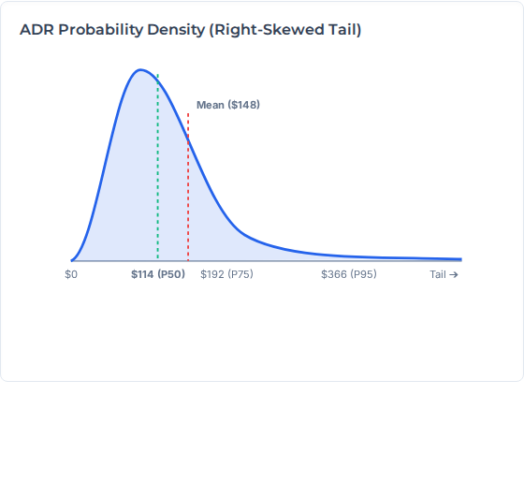




1. Market Distribution & ADR Skewness
The dataset exhibits heavy concentration in specific cities and property types, but the most critical finding lies in the pricing distribution. Analyzing Average Daily Rate (ADR) reveals extreme right-skewness.
Market Dimension | Top Category | Volume Share
City | City A | 45.6% (22,366 bookings)
Property Type | Hotel | 72.2% (35,441 bookings)
Chain Status | Non-Chain | 73.0% (35,825 bookings)
MEDIAN (P50)
MEAN (AVG)
LUXURY (P95)
$114
$148
$366
Statistical Imperative: The Mean is inflated 30.3% above the Median due to a luxury tail ($3,156 Max). Using Mean ADR distorts baselines; strategies must use Median.

Slide 3
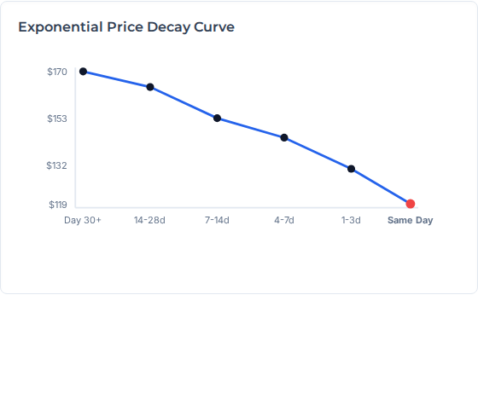

2. The "Price Drop" Paradox vs. Lead Time
Analyzing ADR against booking lead time invalidates the core industry assumption that hotel prices consistently rise closer to check-in. In reality, properties heavily discount distress inventory.
Lead Time Bucket | Share (%) | Avg ADR ($) | Price vs. 30+ Days
30+ days (Baseline) | 17.3% | $170.00 | -
2–4 weeks | 20.0% | $164.00 | -3.5% (-$6)
1–2 weeks | 14.8% | $153.00 | -10.0% (-$17)
4–7 days | 13.9% | $144.00 | -15.3% (-$26)
1–3 days | 22.5% | $132.00 | -22.3% (-$38)
Same Day | 11.4% | $119.00 | -30.0% (-$51)
ECONOMIC DRIVER:
Hotels aggressively lower rates close to check-in to clear distress inventory (a discounted room yields higher marginal revenue than an empty room).
The Trust Risk: "Prices are rising!" is factually misleading for the vast majority of inventory. We must pivot to Inventory Scarcity or verified rate increases.

Slide 4
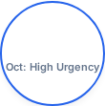
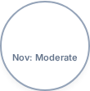






3. Geographic & Temporal Hotspots
Booking behavior is highly heterogeneous. Certain cities represent massive urgency opportunities, while others are dominated by advance planners hostile to last-minute pressure tactics.
% Last-Minute Bookings (≤7 Days) by City
Temporal Seasonality (Q4 2016)
City E
City B
51.6%
48.6%
43.8%
City A
City D
October sees peak urgency ($149 ADR) driven by short-lead business travel. December planning windows expand to 15.7 days due to holiday leisure bookings ($154 ADR).
City C
*City A accounts for 45.6% of all bookings, making its 51.5% urgency rate the largest raw volume opportunity.
Deployment Strategy: City C users plan weeks in advance (20.6 days avg lead time). Exclude City C entirely from urgency tests; focus on E, B, and A.

Slide 5
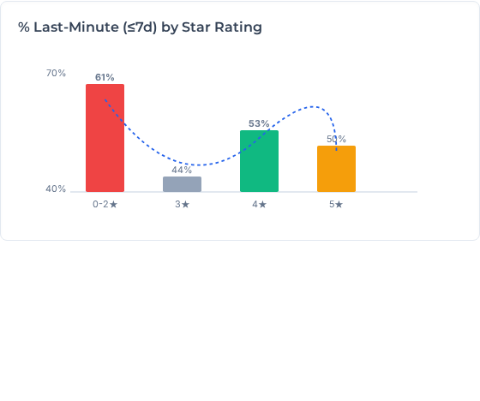

4. Property Tier Analysis: The Urgency U-Curve
Urgency behavior does not scale linearly with star rating; instead, it forms a distinct U-shaped curve, revealing two vastly different psychological drivers for last-minute bookings.
0-2 Stars (61% Avg): Ultra price-sensitive deal hunters operating on extreme short notice. (Low $50–$91 ADR).
3 Stars (44.3%): Mass market families/groups requiring coordination and longer planning windows.
4 Stars (52.7%): Business travelers & spontaneous premium leisure. This is the 🎯 Target Segment.
5 Stars (49.5%): Split between impulse luxury ("treat-yourself") and planned special occasions.
THE 4-STAR COMMERCIAL ADVANTAGE
29.5%
52.7%
$192
Market Share
Urgency Rate
Average ADR

Slide 6


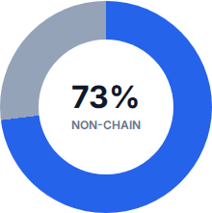

5. Chain vs. Independent Dynamics
Analyzing ownership models highlights a massive divergence in price sensitivity and urgency behavior, guiding where messaging tests will be most effective.
Behavioral Divergence
INDEPENDENT / NON-CHAIN
48.5% Urgency | $129 Avg ADR Highly fragmented, price-sensitive inventory. Represents the bulk testing ground for price/scarcity messaging.
CHAIN PROPERTIES
46.1% Urgency | $200 Avg ADR Lower urgency, commanding a massive 55% price premium. Users typically book corporate rates or leverage brand loyalty.
Testing Ground: Non-chain properties represent 73% of the market and exhibit higher urgency. Limit phase 1 tests exclusively to this segment.

Slide 7

6. The Ultimate Target Matrix (City × Star Rating)
Combining geographic and property tier insights allows us to isolate the exact micro-segments that yield the highest commercial return for urgency messaging.
 | High Urgency (>55%) | Low Urgency (<40%)
High ADR (>$150) | City E - 4⭐ (64.8% / $161) City A - 4⭐ (55.4% / $130) TARGET SEGMENT | City C - 5⭐ (22.8% / $667) City C - 4⭐ (29.3% / $445)
Low ADR (<$150) | City E - 1⭐ (75.6% / $30) City B - 0⭐ (73.5% / $24) | City C - 3⭐ (27.9% / $224) City B - 5⭐ (37.7% / $281)
City E 4-Star: 64.8% urgency (1,480 bookings, 31% of City E). A perfect micro-climate for high-ADR scarcity testing.
City A 4-Star: 55.4% urgency, 5,841 bookings. The massive volume generator for the A/B test pipeline.

Slide 8
7. Statistical Validity & Correlation Testing
To ensure robust experimental design, we tested the Spearman rank correlation between booking lead time and ADR to see if the relationship is statistically significant across markets.
Market | Spearman ρ | P-value | Interpretation
Overall Market | 0.1613 | 2.15e-283 | Highly Significant (Weak Pos)
City A | 0.0843 | 1.52e-22 | Significant
City B | 0.2271 | 1.04e-07 | Significant (Weak Pos)
City C | 0.2094 | 3.30e-02 | Significant (Weak Pos)
City D | 0.0095 | 3.40e-01 | Not Significant
City E | 0.0726 | 4.58e-01 | Not Significant
A/B Testing Framework
Target: 4-Star Non-Chain Properties (Cities E & A).
Control (50%): Standard UI (No Urgency Badging).
Treatment (50%): Dynamic Scarcity + Social Proof.
Guardrail Metrics
Primary Success: Search-to-Book CVR (+2.5% Target).
Risk Metric 1: 24-Hour Cancellation Rate (<0.5% var).
Risk Metric 2: 30-Day Repeat Booking Rate (Trust).

Slide 9





8. Core Recommendations & Funnel Implementation
To maximize conversion without causing user fatigue or friction, urgency messaging must be tailored to specific funnel stages and micro-segments.
Funnel Placement Strategy
1. Search Results
2. Property Page (PDP)
3. Booking Form
Goal: Filter & Contrast Tactic: Social Proof Badges "15 people viewing in City A"
Goal: High Intent Conversion Tactic: Inventory Scarcity "Only 2 rooms left at this price!"
Goal: Friction Reduction Tactic: Trust & Mitigation "Lock in this price today"
Estimated Business Impact: A modest +1.5% CVR lift via Scarcity/Social proof on the 20,000 baseline target bookings yields an estimated $2.5M - $4.0M Annual GBV Lift when scaled globally across matching inventory.

Slide 10

Image Sources
https://cdn.prod.website-files.com/698a15a8c68d8a4f171bf4b3/6a6a1447db9399b85b5b731c_CelLink-ai-infra.jpg
Source: techarena.ai

